Slide 1
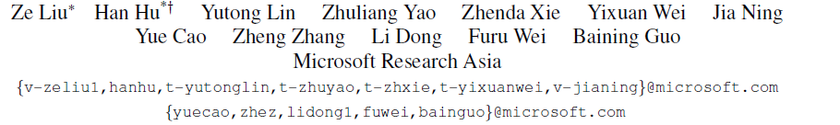

Swin Transformer V2: Scaling Up Capacity and Resolution
https://github.com/SwinTransformer/Swin-Transformer-Object-Detection
Presented by : H.N Srikanth (SM21MTECH12012)
Mentor : Dr. C Krishna Mohan
TA : Sai Harsha

Slide 2
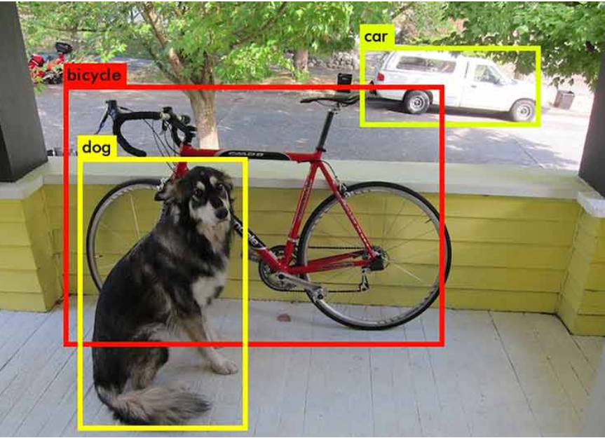
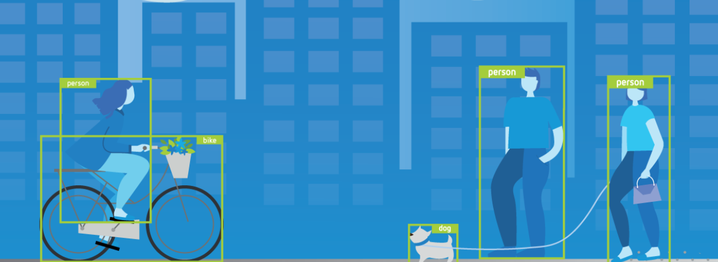
Problem statement
Object Detection
Locate an object in the image.
Create bounding boxes around the target images.

Slide 3
Motivation
Transformer is notable for its use of attention to model long-range dependencies in the data which well performed in NLP tasks.
Challenges in adapting Transformers from NLP to vision are addressed with hierarchical Transformer i.e Swin Transformer.
Vision models are known to perform well at high resolutions. This is achieved by Swin Transformer V2 which gave SOTA results in vision community.

Slide 4
Literature Survey
Swin Transformer : Hierarchical vision transformer using shited windows
Hierarchy, locality and translational invariance are also introduced to vanilla Transformer encoder architecture.
Shifted windowing scheme is implemented with Transformers.
Vision transformer
Transformers are implemented with computer vision problems.
Attention is all you need
Understanding long term dependencies in NLP world.

Slide 5
Advancements with Swin Transformer
Challenges in adapting Transformers from NLP to vision are addressed with hierarchical Transformer i.e Swin Transformer.
Vision models are known to perform well at high resolutions. This is achieved by Swin Transformer V2 which gave SOTA results in vision community.

Slide 6
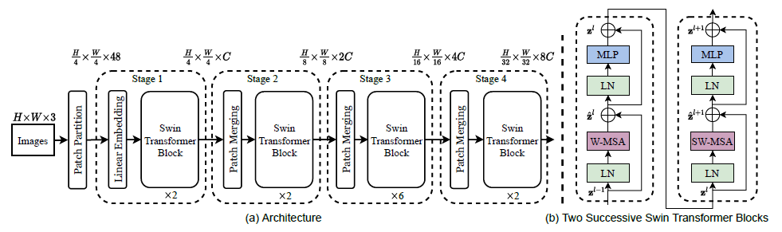
The Model

Slide 7
First splits RGB image into non-overlapping patches by patch splitting module.
A linear embedding layer is applied on it to project it to arbitrary dimension say C.
Several Swin Transformer blocks (Transformer blocks with modified self attention computation) are applied on it.
These produce feature maps similar to typical convolutional layers .

Slide 8
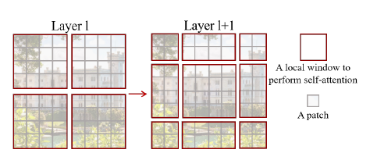
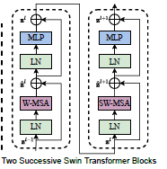
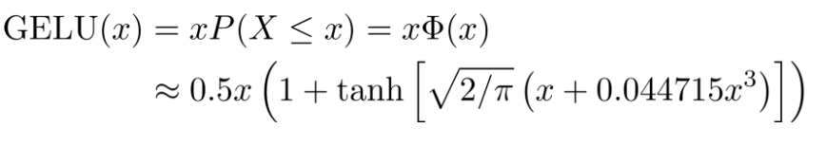
Swin Transformer block
It consists of shifted window based multi head self attention followed by 2 layer NLP.
A GELU non linearity is embedded in between
A layernorm is applied before each MSA module and each MLP module.
A residual connection is applied after each module.
Gaussian error linear unit

Slide 9
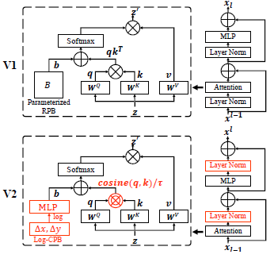
In V2
Post norm replaced Prenorm
Scaled cosine attention replaced Dot product attention
Log CPB replaced Parameterized approach

Slide 10
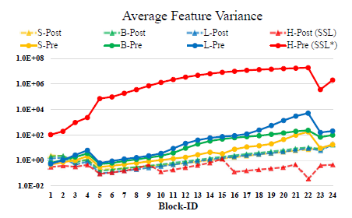
Scaling up Model Capacity
Activation values in deeper layers grow dramatically.
Post Normalization is used to reduce the activation amplitudes in the deeper layers.
Scaled Cosine attention is used to get milder attention values.
Signal Propagation Plot

Slide 11
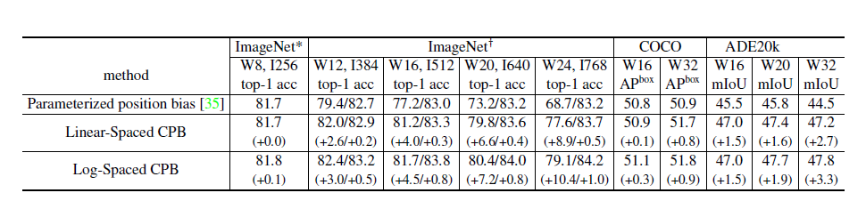
Scaling up window resolution
Log spaced coordinates are used to reduce the extrapolation ratio required to transfer pre trained model to higher window sizes.
Log-spaced CPB gives better values when compared to Parametrized position bias

Slide 12
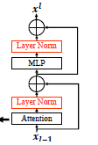
Layer norm is implemented after MLP block which results in Post Normalization.
This is one of the reason behind scaling up the capacity.

Slide 13
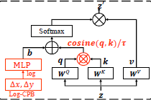
Other changes in SWIN Transformer block
A scaled cosine attention approach is implemented to get rid of dominated pixel pairs.
Sim(q_{i} , k_{j}) = cos (q_{i},k_{j})/ꞇ + B_{ij}
B_{ij} is relative position bias between i and j Ꞇ is learnable scalar.
This is another reason behind scaling up the capacity.

Slide 14
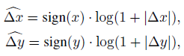
With Log spaced continuous positional bias, extrapolation ratio will decrease thereby transferring between windows will be feasible.
where Δx, Δy and are the linear-scaled and logspaced coordinates, respectively.
This is reason behind scaling up window resolution
For example extrapolation ratio to shift from 8*8 to 16*16 window size is 1.14x with parameterized approach . It will reduce to 0.33x in log spaced approach.

Slide 15
Other implementations
Zero-Redundancy Optimizer, activation check-pointing and sequential self-attention computation are other implementations done to save GPU memory
By these settings 3B parameters model is implemented on COCO object detection dataset.
Data hungry issue is resolved by using self supervised approach.

Slide 16
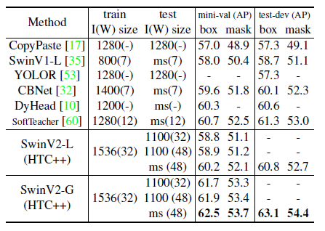
Results
Comparison is done with respect to COCO dataset

Slide 17
Future work
Working on reproducing results of SWIN T backbone with Mask RCNN model.
Will try to bring novelty by working on dropout layers.
Will implement India Japan POTHOLE dataset on modified SWIN V2 G model.

Slide 18
References
An Image is Worth 16x16 Words: Transformers for Image Recognition at Scale
https://arxiv.org/abs/2010.11929v2
The Illustrated Transformer by jay alammar
https://jalammar.github.io/illustrated-transformer/
Swin Transformer: Hierarchical Vision Transformer using Shifted Windows
https://arxiv.org/abs/2103.14030
Attention Is All You Need
https://arxiv.org/abs/1706.03762
Stand-Alone Self-Attention in Vision Models
https://proceedings.neurips.cc/paper/2019/file/3416a75f4cea9109507cacd8e2f2aefc-Paper.pdf

Slide 19
Brief recap:
CNNs served as the standard backbone throughout computer vision for many years.
Self attention based backbones came into play because of their success in NLP.
But the adaption of Transformers into vision is not easy because of large image size and big capacity of the models required.
Swin Transformer is one of the attempt to overcome these capacity and resolution issues which gave notable SOTA results in vision community.
But interestingly Convnets came back with A ConvNet for the 2020s paper published earlier in this year by Facebook AI

Slide 20
Thank You

